Slide 1

Information and Communication Technologies (ict)

Slide 2
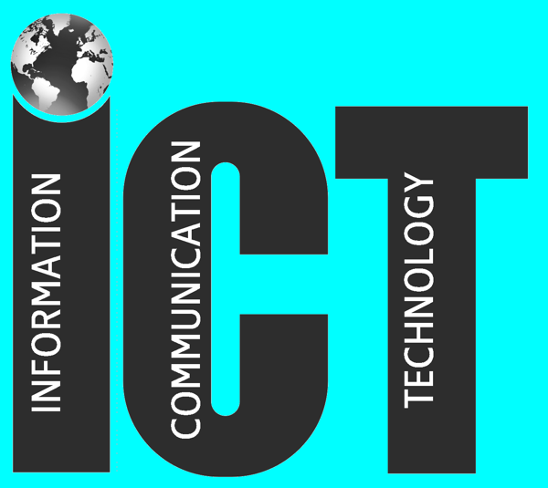
This repostory is about :
In This repository we delve into the world of Technology and Information Communication (TIC), going beyond traditional IT. It showcases diverse TIC tools, from cloud computing to AI and social media, and serves as an interactive platform for learning and collaboration. The aim is to collectively leverage TIC's power for a more connected and innovative future.
,
Cette photo par Auteur inconnu est soumise à la licence CC BY-NC-ND

Slide 3
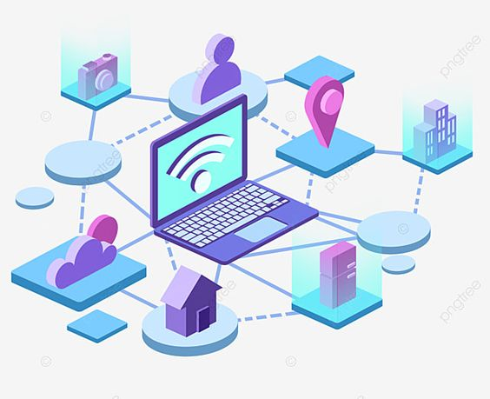
ict
where information flows freely and seamlessly, shaping every aspect of our lives!

Slide 4
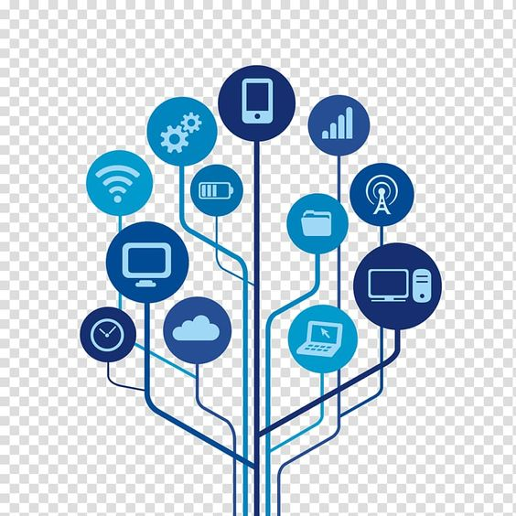
What is TIC ? :
TIC surpasses conventional IT by not only including tools for processing and managing information but also a sophisticated communication channels

Slide 5
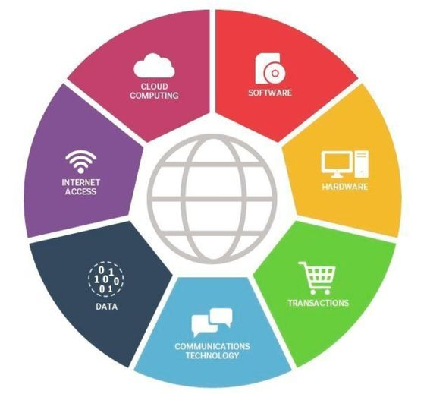
TIC Components :
Tools for information processing and communication channels
"TIC encompasses processing tools and communication channels"

Slide 6
(Ict) technology empowers us to:
. Transmit and Share
. Exchange and Collaborate
. Generate and Store
. Process and Analyze
. Bullet points on each

Slide 7
ict Tools :
Cloud Computing: AWS, Azure…
Web Développement: HTML, CSS..
Social Media: Twitter, Facebook..
Cyber Security: Firewalls, antivirus…
Emerging Technologies: AI, Blockchain..
Bullet points on each

Slide 8

Conclusion :
TIC is an excellent and even the best way to share, store and process information
with different types of tools and with the simplest means.
Let's leverage the power of ICT to build a more connected, informed and innovative future!

